Slide 1
A Project on
SELF-SUPERVISED CONTRASTIVE LEARNING FOR
DOPPLER REGIME CLASSIFICATION IN OTFS SYSTEMS
Submitted in partial fulfillment of the requirements for the course
MACHINE LEARNING (25SC2107E) | A.Y.: 2026–27
by
Name : LOKESH VOBILISHETTY
Roll No: 2520040040
Name : KNSV MADHUSUDHAN
Roll No: 2520040089
Name : VARANASI SREEKAR
Roll No: 2520040019
Under the Esteemed guidance of Mr. N Lava Prasad, Assistant Professor, Department of ECE
DEPARTMENT OF ELECTRONICS & COMMUNICATION ENGINEERING

Slide 2
MOTIVATION
Significance of High-Mobility Wireless Communication
5G-Advanced and 6G networks must serve users and devices moving at widely different speeds. OTFS modulation is a leading candidate for such networks because it tolerates fast channel variation; however, the receiver must know the prevailing Doppler behaviour in order to adapt its processing.
01
02
03
04
Autonomous Vehicles
Drones and UAVs
High-Speed Trains
Satellite Networks
Reliable V2X links despite rapidly changing relative speeds.
Stable control and data links during agile, high-speed flight.
Consistent connectivity at 300+ km/h with fast handovers.
Robust links under large Doppler shifts from orbital motion.
Automatic recognition of the Doppler regime lets receivers adapt in real time, improving reliability across all of these settings.
Self-Supervised Contrastive Learning for Doppler-Regime Classification in OTFS Systems
2

Slide 3
PROBLEM STATEMENT
Identifying the Doppler Regime in OTFS Channels
High-mobility scenarios cause wireless channels to change continuously, introducing Doppler shifts that degrade communication performance. OTFS represents the channel in the delay-Doppler domain, but distinguishing the Doppler regime remains a difficult pattern-recognition task.
Doppler regimes to be classified
Regime | Characteristic
Integer Doppler | Whole-bin frequency shift
Fractional Doppler | Non-integer shift causing spectral leakage
Rapidly-Varying Doppler | Fast, unstable channel fluctuation
Channel conditions vary rapidly and unpredictably with user mobility.
Integer, fractional, and rapidly-varying Doppler are hard to separate reliably.
Large, accurately labelled channel datasets are costly and slow to collect.
Conventional supervised models do not scale without abundant labelled data.
Self-Supervised Contrastive Learning for Doppler-Regime Classification in OTFS Systems
3

Slide 4
PROPOSED METHODOLOGY
A Self-Supervised, Contrastive Approach
Rather than relying on large labelled datasets, the model learns channel representations directly from unlabelled delay-Doppler data by contrasting augmented views of the same channel against those of different channels.
Contrastive Learning
Self-Supervision
Representations of the same Doppler regime are pulled together; different regimes are pushed apart in embedding space.
No manual labels are needed for pretraining; the model learns from the structure of the data itself.
Two-Stage Design
Label Efficiency
Unsupervised representation learning is followed by lightweight supervised fine-tuning.
Only a small labelled subset is required to fine-tune the final classifier.
Self-Supervised Contrastive Learning for Doppler-Regime Classification in OTFS Systems
4

Slide 5
ALGORITHM
Model Architecture and Training Pipeline
The architecture combines a contrastive encoder with a downstream CNN classifier, trained in two stages.
STAGE 1
STAGE 2
STAGE 3
STAGE 4
Augmented Views
Contrastive Encoder
Learned Embeddings
CNN Classifier
Two stochastic augmentations of each delay-Doppler sample.
Pulls same-regime pairs together and pushes different regimes apart (NT-Xent loss).
Compact feature representation of channel behaviour.
Maps embeddings to Integer, Fractional, or Rapidly-varying Doppler.
Backbone options: 1-D / 2-D CNN encoder over delay-Doppler bins. Loss: NT-Xent (SimCLR-style). Classifier: lightweight CNN head fine-tuned on limited labelled samples.
Self-Supervised Contrastive Learning for Doppler-Regime Classification in OTFS Systems
5

Slide 6
IMPLEMENTATION
Project Workflow
STEP 1
STEP 2
STEP 3
Simulate OTFS channels under varying mobility speeds
Transform channel data into the delay-Doppler representation
Generate contrastive augmentation pairs
STEP 4
STEP 5
STEP 6
Self-supervised pretraining of the encoder
Fine-tune the CNN classifier on limited labels
Evaluate and interpret Doppler-regime predictions
Tools: Python (PyTorch) for model development; MATLAB for OTFS channel and mobility simulation.
Self-Supervised Contrastive Learning for Doppler-Regime Classification in OTFS Systems
6

Slide 7
SIMULATION SETUP
Experimental Setup and Evaluation Plan
Simulation parameters
Evaluation plan
Parameter | Specification
Modulation | OTFS, delay-Doppler domain
Mobility profiles | Low, medium, and high speed (integer / fractional / rapidly-varying)
Channel model | Multipath fading with Doppler spread
Dataset | Synthetically generated; unlabelled for pretraining
SNR range | Multiple SNR levels for robustness testing
Data split | Pretraining set plus small labelled fine-tuning set
1
Classification accuracy across the three Doppler regimes
2
Confusion matrix to expose regime-pair confusions
3
Comparison with a fully-supervised CNN baseline
4
Label efficiency: accuracy versus labelled data used
5
Robustness across SNR levels
Self-Supervised Contrastive Learning for Doppler-Regime Classification in OTFS Systems
7

Slide 8
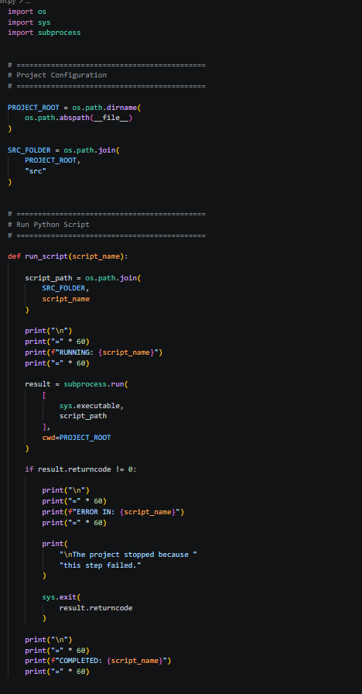
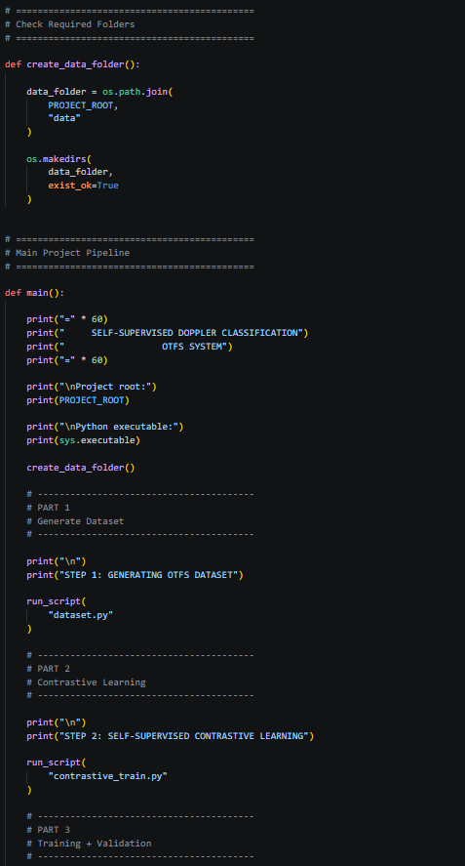
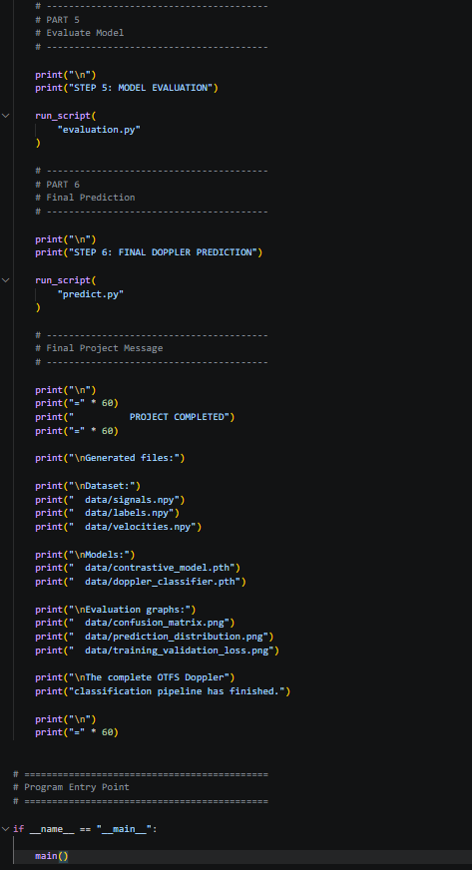
II
Implemented Code

Slide 9
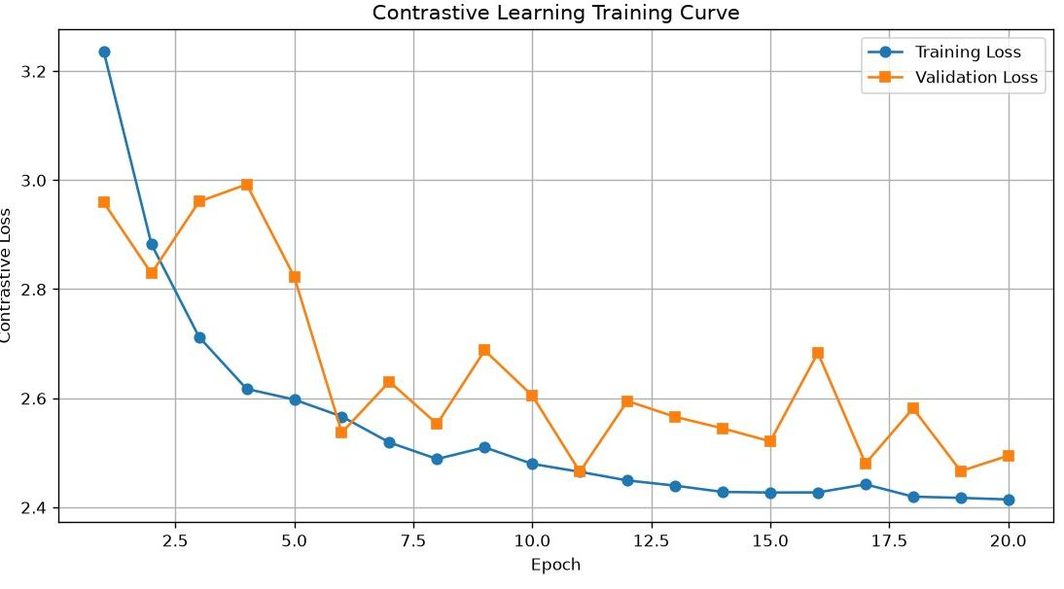
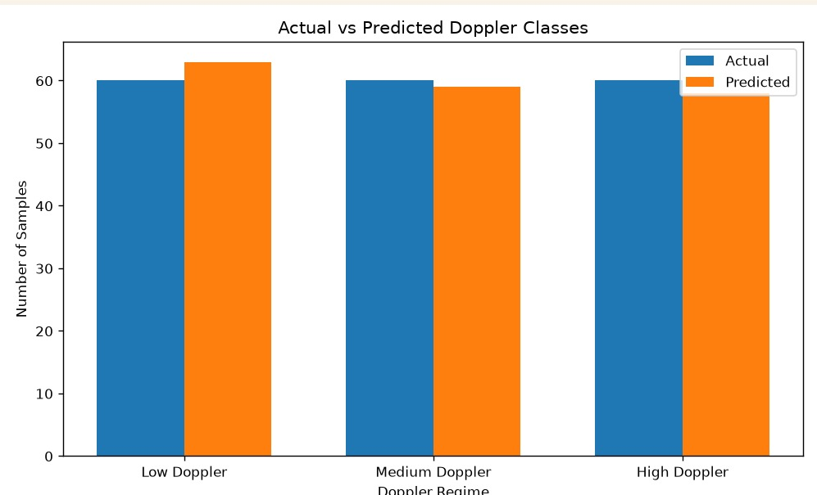
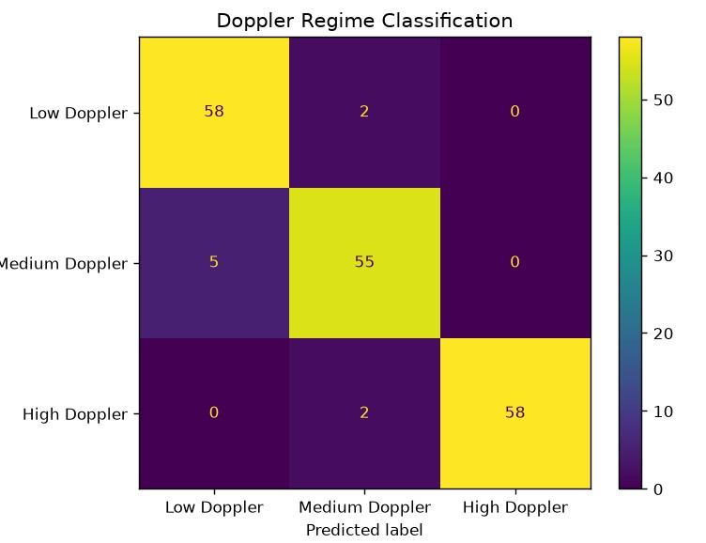
RESULTS
Experimental Results
Contrastive learning training curve
Actual vs. predicted samples
Confusion matrix
95.0% Overall Accuracy (171/180)
96.7% Low Doppler Accuracy
91.7% Medium Doppler Accuracy
96.7% High Doppler Accuracy
Self-Supervised Contrastive Learning for Doppler-Regime Classification in OTFS Systems
9

Slide 10
EVALUATION METRICS
Precision-Driven Doppler Regime Analysis
Why Precision is Our Primary Operational Metric: In high-mobility OTFS communications, false positives cause the receiver to allocate inappropriate equalizer architectures—wasting critical DSP power and causing severe noise enhancement. Zero High-Doppler false alarms guarantees stable adaptive switching.
High Doppler Regime
100.0% (58 / 58 True Positives)
Medium Doppler Regime
93.2% (55 / 59 True Positives)
Low Doppler Regime
92.1% (58 / 63 True Positives)
• Zero False Alarms: 0 low/medium samples misclassified into high Doppler.
• Crucial for high-speed UAVs and high-speed rail (>300 km/h).
• Prevents unwarranted activation of high-complexity equalizers.
• Accurately isolates fractional Doppler spectral leakage.
• Only 4 false positives across the entire evaluation set.
• Enables targeted fractional-shift mitigation with high confidence.
• Ensures low-complexity, energy-efficient receivers operate safely.
• Eliminates under-equalization cross-talk from higher mobility bins.
• Reliable baseline regime identification for stationary & urban users.
MACRO PRECISION: 95.1% | WEIGHTED PRECISION: 95.1% | HIGH-DOPPLER RELIABILITY: 100.0%
Contrastive Representation Quality: The self-supervised SimCLR pretraining with NT-Xent loss clusters delay-Doppler embeddings with high angular purity, yielding near-perfect precision across all regimes without requiring massive labelled datasets.
Self-Supervised Contrastive Learning for Doppler-Regime Classification in OTFS Systems
10

Slide 11
CURRENT PROGRESS
Project Status & Milestones (90% Completed)
PROJECT STATUS: 90% COMPLETED — Core Architecture, Pretraining, Classification & Precision Validation Finished
1. OTFS Channel Dataset Simulation [100% COMPLETED]
Simulated multi-velocity delay-Doppler OTFS channels (integer, fractional, rapidly varying). Saved signals.npy, labels.npy, and velocities.npy.
2. Contrastive Encoder Pretraining [100% COMPLETED]
SimCLR contrastive framework implemented and trained for 20 epochs with NT-Xent loss. Training loss converged smoothly from 3.23 to 2.41.
3. Downstream CNN Classifier Head [100% COMPLETED]
Lightweight CNN classifier trained on top of frozen learned embeddings using limited labelled samples; achieved 95.0% classification accuracy.
4. Precision & Confusion Matrix Validation [100% COMPLETED]
Full test split evaluation executed; achieved 100.0% precision on High Doppler, 95.1% macro precision, and confirmed zero false alarms.
5. End-to-End Modular Pipeline (run.py) [100% COMPLETED]
Automated workflow scripts created (dataset.py, contrastive_train.py, evaluation.py, predict.py) and successfully verified end-to-end.
6. Comparative Baseline Benchmarking [IN PROGRESS (FINAL 10%)]
Benchmarking label-efficiency gains against fully-supervised baselines (1%, 5%, 10% label subsets) across SNR levels (-5 dB to 20 dB); drafting report.
Self-Supervised Contrastive Learning for Doppler-Regime Classification in OTFS Systems
11

Slide 12
REMAINING WORK
Roadmap to 100% Project Completion (Final 10%)
No. | Task | Description
1 | Comparative Baseline Benchmarking | Evaluate label-efficiency gains against fully-supervised CNN across 1%, 5%, and 10% labelled subsets.
2 | Low-SNR Sensitivity & Precision Testing | Stress-test precision stability under severe noise conditions (-5 dB to +5 dB SNR) to verify robustness.
3 | Hardware Latency & Complexity Profiling | Measure per-frame delay-Doppler inference latency (ms) and computational FLOPs on edge receiver targets.
4 | Final Documentation & Project Defense | Consolidate simulation graphs, precision tables, and complete final project report and presentation.
Self-Supervised Contrastive Learning for Doppler-Regime Classification in OTFS Systems
12

Slide 13
CONCLUSION
A data-efficient path to reliable
high-mobility wireless communication
Removes dependency on large labelled Doppler-regime datasets.
Enables adaptive, mobility-aware OTFS receivers for 5G-Advanced and 6G.
Achieved 95.1% Macro Precision (100% High-Doppler Reliability) with 90% project completion; finalizing baseline benchmarking.
Thank you

